Slide 1
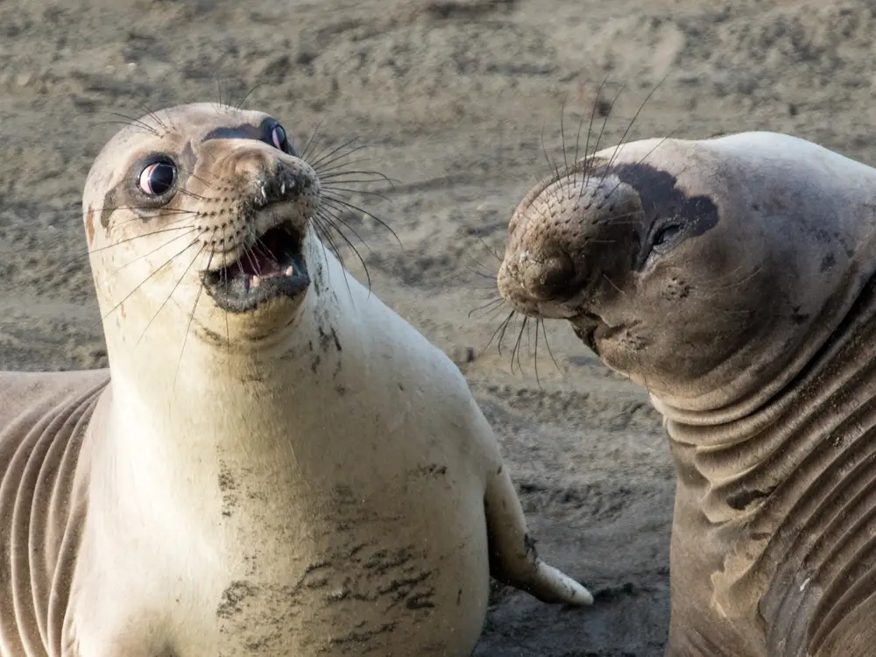
Week 9
PV, PVC, Storageclass and Statefulsets

Slide 2
Agenda
Kubernetes Volumes – hostPath
PersistentVolume
PersistentVolumeClaim
StorageClass
StatefulSet

Slide 3
Volumes: hostPath
First persistent storage – not deleted when the pod is deleted
hostPath should not be used to store application's data
Used by pods to get access to host data, e.g. kubeconfig or /var/log or OS devices through file system
Used as a persistent volume in simulated clusters like "kind" and "minikube"
Stored on a specific node – is it suitable for DB storage?
What if we need to persist data in a cluster with multiple worker nodes?

Slide 4
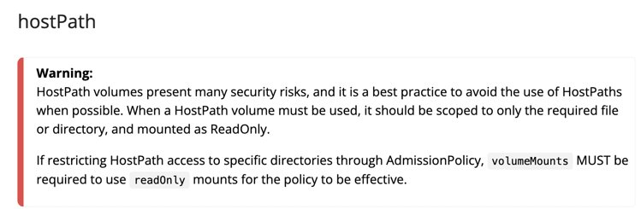
hostPath Concerns
HostPaths can expose privileged system credentials
Pods with identical configuration (such as created from a PodTemplate) may behave differently on different nodes due to different files on the nodes
The files or directories created on the underlying hosts are only writable by root.

Slide 5
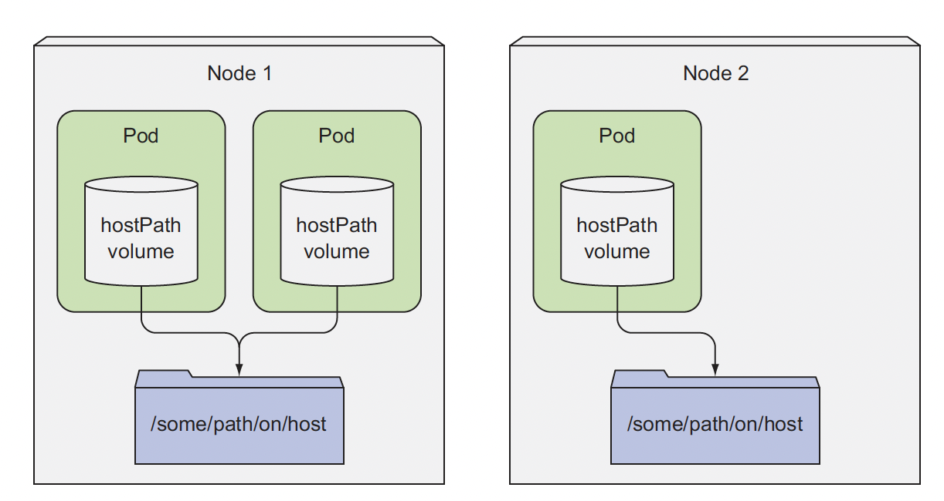
Data Sharing between the node and the Pod's containers with hostPath volume

Slide 6
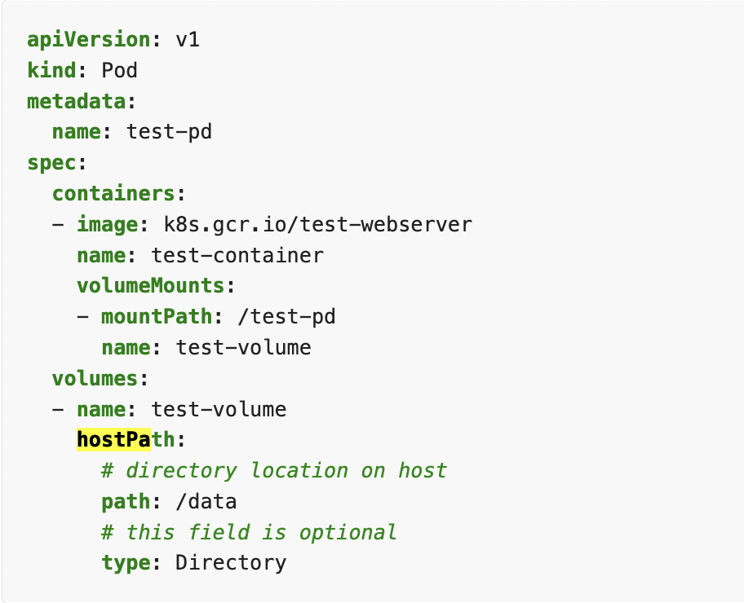
hostPath Configuration Example

Slide 7
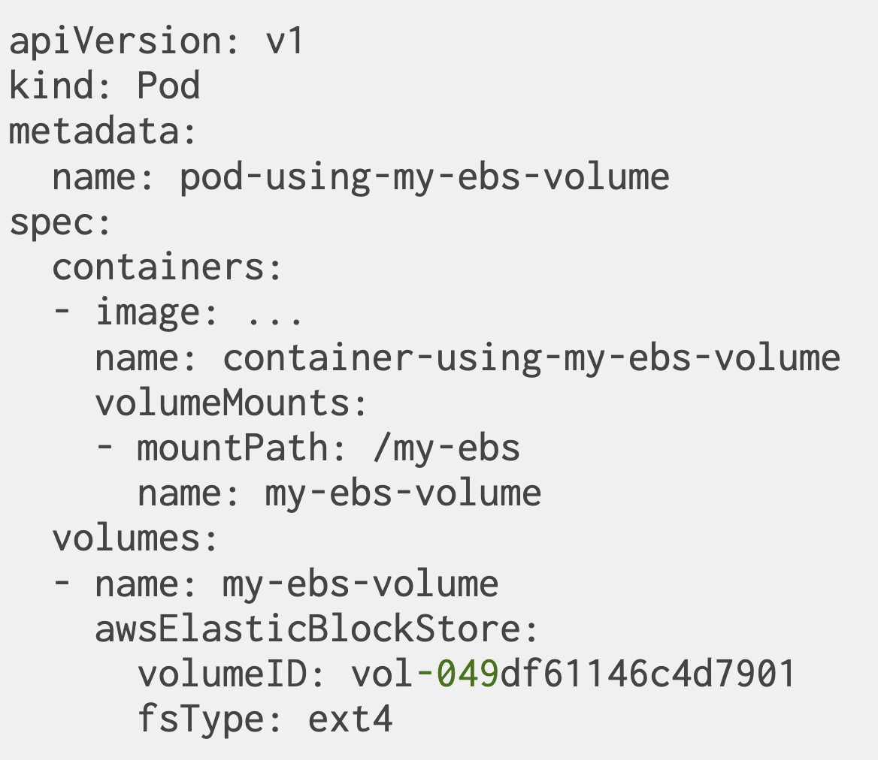
Persistent Volumes: Amazon EBS
Using a persistent volume requires:
creating the volume out-of-band (outside of the Kubernetes API)
referencing the volume in the pod description, with all its parameters

Slide 8
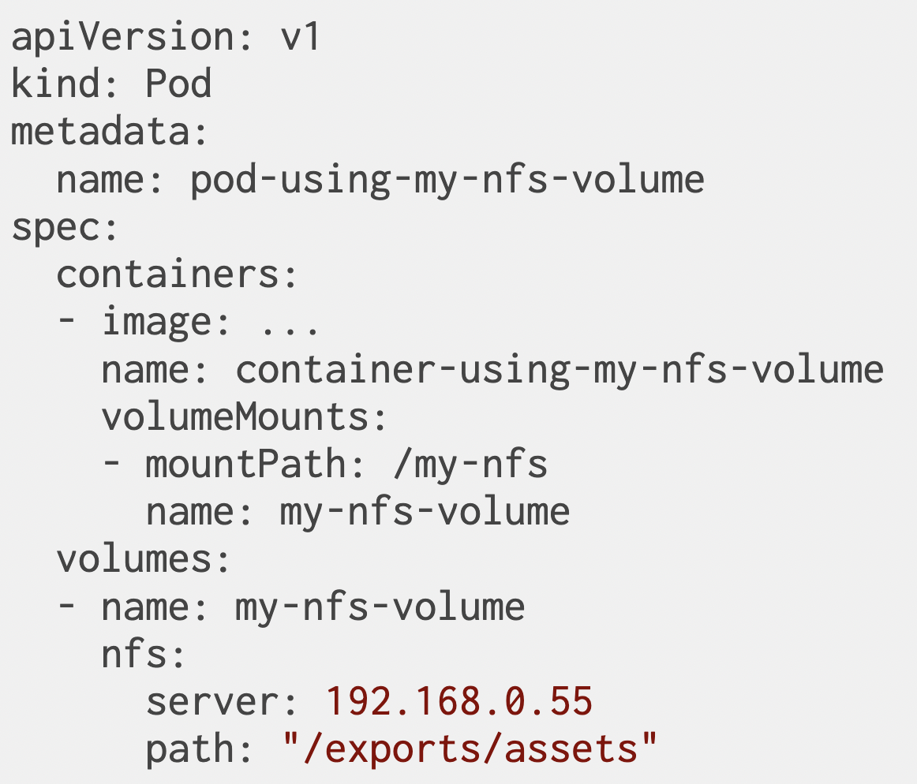
Using NFS Volume

Slide 9
Challenge of Volumes
Should be pre-deployed
Requires the app developer to know the infrastructure details
Locks pod definition to a specific cluster

Slide 10
Workshop 1 - Exploring hostPath

Slide 11
Deploy MongoDB to Amazon EKS
# Verify the cluster is running
$ k get nodes
# Create Amazon EKS cluster if there is no active cluster
$ eksctl create cluster clo835 –f eks_config.yaml
# Make sure the cluster is running
$ k get nodes
# Create the namespace
$ k create ns week9
# Deploy mongodb app backed by the hostpath
$k apply -f mongodb_hostpath.yaml -n week9

Slide 12
Add Sample Data to MongoDB
# Start mongo shell in the mongo cotainer
$ k exec -it mongodb -n week9 -- mongosh # Please note that mongo client was replaced with mongosh
# Add sample json document to the DB
> use mystore
switched to db mystore
> db.foo.insert({name:'foo'})
WriteResult({ "nInserted" : 1 })
> db.foo.find()
{ "_id" : ObjectId("57a61eb9de0cfd512374cc75"), "name" : "foo" }
# Exit the container and mongoDB shell
> exit
Bye
# Examine the node that the pod is scheduled to
$ k get pods -o wide -n week9
NAME READY STATUS RESTARTS AGE IP NODE NOMINATED NODE READINESS GATES
mongodb 1/1 Running 0 13m 192.168.53.113 ip-192-168-40-207.ec2.internal <none> <none>

Slide 13
Add Sample Data to MongoDB
# Delete the pod and create a new one
kubectl delete pod mongodb -n week9
# Recreate the mongoDB pod
$ k apply -f mongodb_hostpath.yaml -n week9
# Let's examine the data – it turns out to be hit and miss. Why?
$ k exec -it mongodb -n week9 -- mongosh
> use mystore
switched to db mystore
> db.foo.find() # data persisted. What would happen if the pod is scheduled to a different node?
{ "_id" : ObjectId("62c5b2586a2dbca9f32d3213"), "name" : "foo" }
# Examnine the node that the pod is scheduled to
$ k get pods -n week9 -o wide
NAME READY STATUS RESTARTS AGE IP NODE NOMINATED NODE READINESS GATES
mongodb 1/1 Running 0 5m42s 192.168.53.113 ip-192-168-40-207.ec2.internal <none> <none>

Slide 14
HostPath with Amazon EBS
# Provision Amazon EBS volume
$ aws ec2 create-volume --volume-type gp2 --size 80 --availability-zone us-east-1a
# Update the mongodb_aws.yaml with the value of the volume just created
$ k apply -f mongodb_aws.yaml -n week9
# Using it is hit and miss – what if the pod is not assigned to the node in the AZ of our Amazon EBS volume
# There should be a better way!

Slide 15
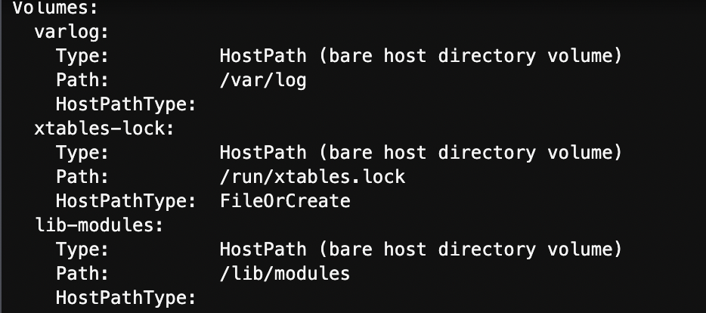
Why to have hostPath at all – Examine kube-proxy
# System pods are using hostPath extensively
$ k get all –n kube-proxy
# Select any of the kube-proxy pods, the name of the pod will be kube-proxy-<random string>
$ k describe pod/kube-proxy-<random string> -n kube-system

Slide 16
Workshop 1 - The End

Slide 17
PV, PVC, and StorageClasses

Slide 18
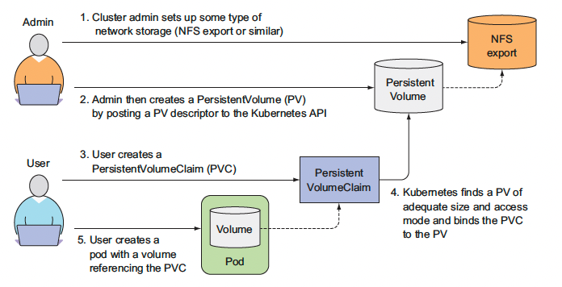
Introducing PersistentVolumes and PersistentVolumeClaims

Slide 19
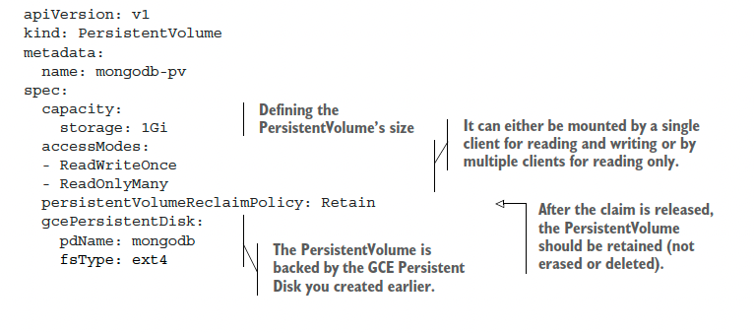
PersistentVolume Manifest

Slide 20
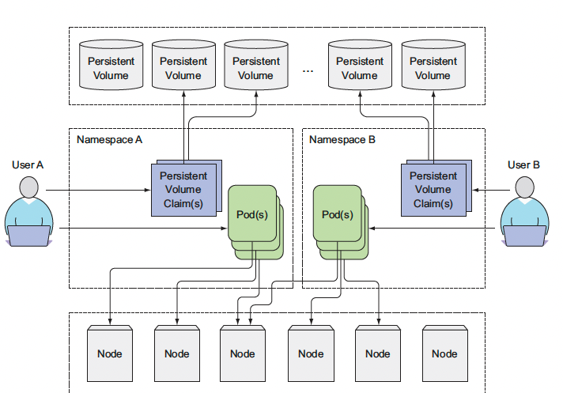
Decoupling pods from the underlying storage technology

Slide 21
Using PrsistentVolumes
When an application needs storage, it creates a PersistentVolumeClaim (either directly, or through a volume claim template in a Stateful Set)
The PersistentVolumeClaim is initially Pending
Kubernetes then looks for a suitable PersistentVolume (maybe one is immediately available; maybe we need to wait for provisioning)
Once a suitable PersistentVolume is found, the PVC becomes Bound
The PVC can then be used by a Pod (as long as the PVC is Pending, the Pod cannot run)

Slide 22
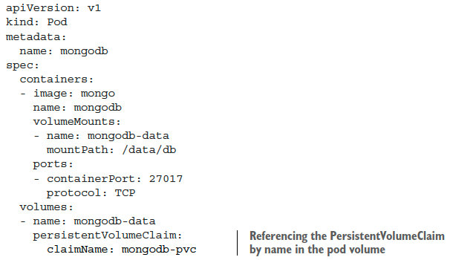
Using a PersistentVolumeClaim in a pod

Slide 23
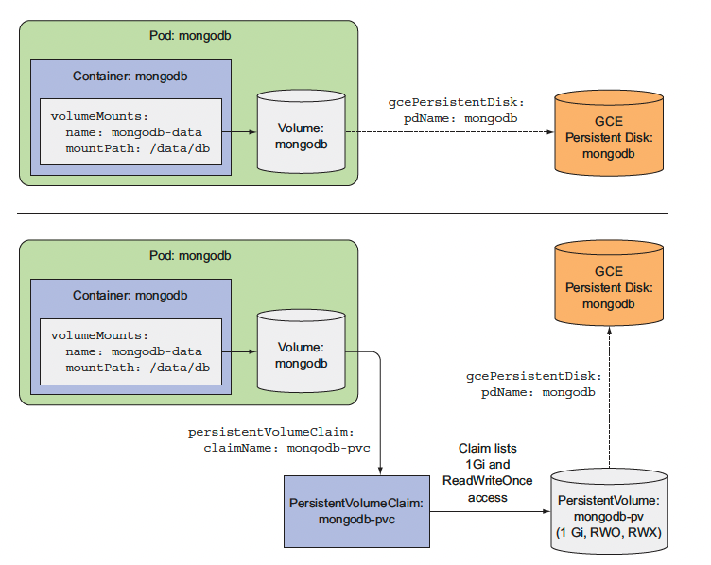
Understanding the benefits of using PersistentVolumes and claims

Slide 24
Provisioning Automation: Storage Class
What if we have multiple storage systems available? (e.g. NFS and iSCSI; or AzureFile and AzureDisk; or Cinder and Ceph...)
What if we have a storage system with multiple tiers? (e.g. SAN with RAID1 and RAID5; general purpose vs. io optimized EBS...)
Kubernetes lets us define storage classes to represent these(see if you have any available at the moment with kubectl get storageclasses)

Slide 25
Using storage classes
Optionally, each PV and each PVC can reference a StorageClass (field spec.storageClassName)
When creating a PVC, specifying a StorageClass means “use that particular storage system to provision the volume!”
Storage classes are necessary for dynamic provisioning (but we can also ignore them and perform manual provisioning)

Slide 26
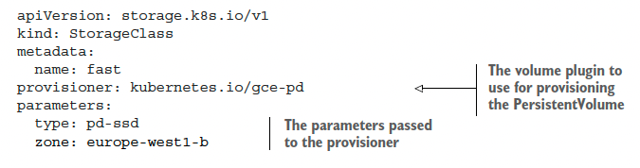
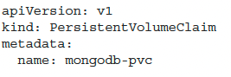
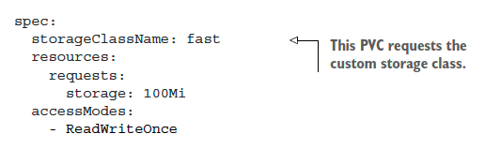
Storage Class Manifest
Notes:
https://kubernetes.io/docs/concepts/storage/storage-classes/#aws-ebs

Slide 27
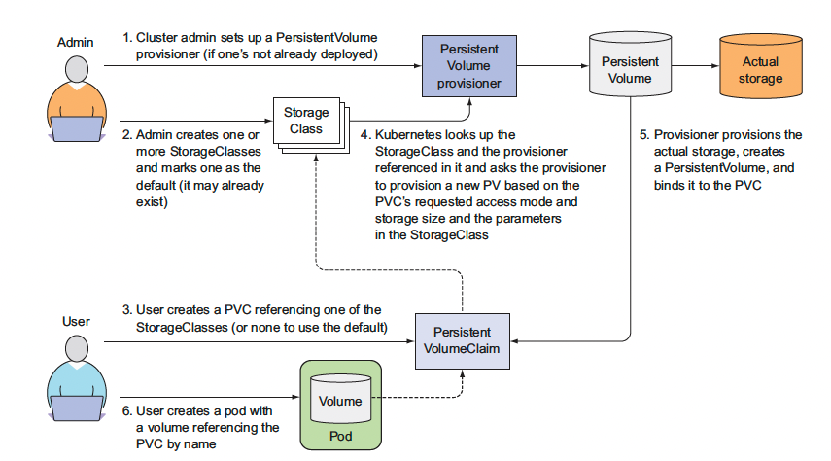
Dynamic PersistentVolume Provisioning

Slide 28
Workshop 2– PV, PVC, StorageClasses
Notes:
https://github.com/luksa/kubernetes-in-action/tree/master/Chapter06
https://aws.amazon.com/premiumsupport/knowledge-center/eks-persistent-storage/
https://kubernetes-on-aws.readthedocs.io/en/latest/user-guide/using-volumes.html

Slide 29
Amazon EBS backed Volume – Data persists independent of the hosting node
# Create redis deployment, service and PVC
$ k get sc
$ k create ns week9
$ k apply -f redis_service.yaml -n week9
$ k apply -f redis_pvc.yaml -n week9
# Review the created PVC and PV, describe the created PV and PVC
$ k get pvc –n week9
$ k apply -f redis_deployment.yaml -n week9
# Add PVC mount to Redis deployment manifest and redeploy Redis
$ k delete deployment redis -n week9
$ k apply -f redis_deployment.yaml -n week9

Slide 30
Store data in redis and Recreate the pod
# Run redis cli client
$ kubectl run redis-cli --rm -ti --image=redis:3.2.5 --restart=Never -- /bin/sh
# redis-cli -h redis.week9.svc.cluster.local
> set foo bar
> get foo
"bar"
> quit
# Delete the pod
$ k delete pod-xxx redis -n week9
# Notice if the pod got rescheduled to another node
$ k get pods –n week9
# run redis cli and verify that data is still availble when the pod gets rescheduled to another node
$ kubectl run redis-cli --rm -ti --image=redis:3.2.5 --restart=Never -- /bin/bash
# redis-cli -h redis.week9.svc.cluster.local
> get foo

Slide 31
Workshop 2 – The End
Notes:
https://github.com/luksa/kubernetes-in-action/tree/master/Chapter06
https://aws.amazon.com/premiumsupport/knowledge-center/eks-persistent-storage/
https://kubernetes-on-aws.readthedocs.io/en/latest/user-guide/using-volumes.html

Slide 32
deploying clustered applications

Slide 33
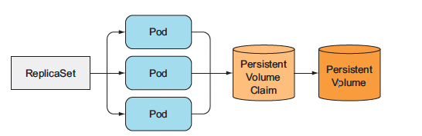
SCALING PODS that reference Persistent volume
All the replicas in the replicaset are identical
All pods in the replicaset will reference the same volume since volume are defined at a pod level
What we are deploying a stateful application (DB) and ach replica needs to have an independent storage

Slide 34
Stable network identity for pods
Clustered applications also require that each instance has a long-lived stable identity (hostname and IP)
Each member of the stateful application's cluster need to know network identities of all member of the cluster
This would not work with applications created with K8s deployment – each time the pods is re-created it's IP and hostname changes

Slide 35
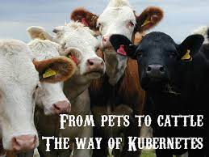
Statefulsets
StatefulSet manages the deployment and scaling of a set of Pods, and provides guarantees about the ordering and uniqueness of these Pods, suitable for applications that require one or more of the following.
Applications are treated as non-fungible individuals, with each one having a stable name and state. (pets vs cattle analogy)
Stable, unique network identifiers
Stable, persistent storage
Ordered, graceful deployment and scaling
Ordered, automated rolling updates

Slide 36
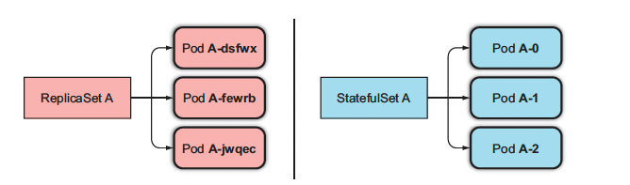
Sttatefulsets vs replicasets
Pods in ReplicaSet are like cattle. They are indistinguishable and replaceable. If the pod dies a new pod with anew IP/hostname and data is created.
Pods in Stateful sets are like pets. When a "pet" dies, it needs to be resurrected with the same name, IP and data. Pods in Statefulsets are not replicas of each other. They can have individual volumes (data).

Slide 37
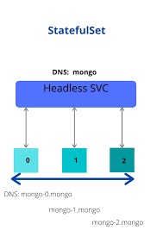
Exposing Statefulsets
Headless service, ClusterIP: None
Each pod has its own DNS enty, e.g. a-0.foo.default.svc.cluster.local

Slide 38
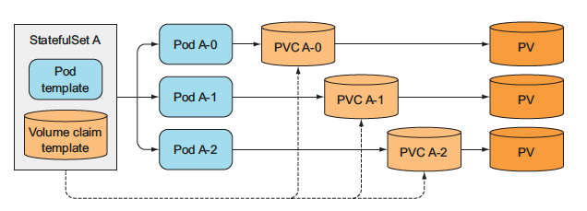
Adding volumes to statefulset's pods
Storage needs to be persistent and decoupled from pods
Each pod needs to reference a different PVC
PVCs need to be created by Statefulset and not separately as we did for the stateless pods

Slide 39
Workshop 3 statefulsets
Notes:
https://github.com/luksa/kubernetes-in-action/tree/master/Chapter10
https://aws.amazon.com/premiumsupport/knowledge-center/eks-persistent-storage/
https://kubernetes-on-aws.readthedocs.io/en/latest/user-guide/using-volumes.html

Slide 40
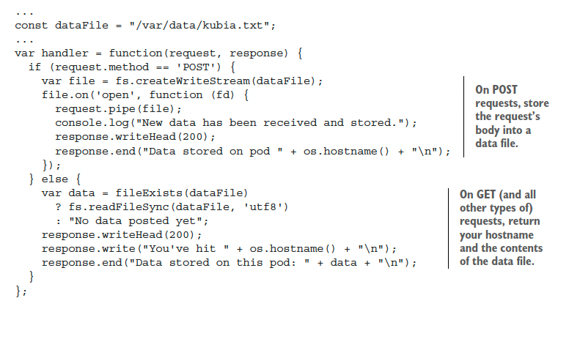
Application functionality
On "POST", store the data in a local file
On GET, return the hostname and the content of the file
https://github.com/luksa/kubernetes-in-action/blob/master/Chapter10/kubia-pet-image/app.js
Notes:
https://github.com/luksa/kubernetes-in-action/blob/master/Chapter10/kubia-pet-image/app.js

Slide 41
What are we creating?
StatefulSet
Governing service
PersistentVolumeClaims as part of StatefulSet manifest. Volume provisioning will be handled by AWS EBS provisioner if we use default StorageClass gp2.
https://github.com/luksa/kubernetes-in-action/blob/master/Chapter10/kubia-statefulset.yaml

Slide 42
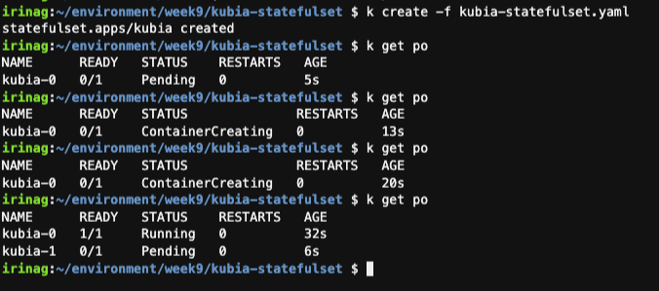
Deployment - statefulset
# Pods are created one by one, unlike replicaset where all pods are created at once
$ k create –f kubia-statefulset
$ k get pvc
$ k get pv

Slide 43
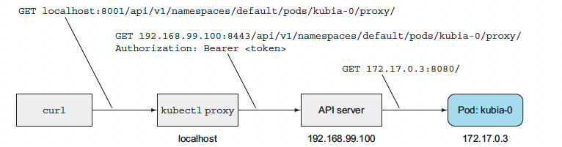
Communicating with the application via proxy
$ kubectl proxy
$ curl localhost:8001/api/v1/namespaces/default/pods/kubia-0/proxy/
curl -X POST -d "Hey there! This greeting was submitted to kubia-0."
curl -X POST -d "Hey there! This greeting was submitted to kubia-0." localhost:8001/api/v1/namespaces/default/pods/kubia-0/proxy/
curl localhost:8001/api/v1/namespaces/default/pods/kubia-0/proxy/
curl localhost:8001/api/v1/namespaces/default/pods/kubia-1/proxy/

Slide 44
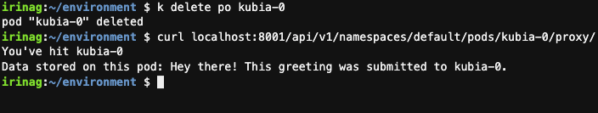
DELETING A STATEFUL POD TO SEE IF THE RESCHEDULED POD IS REATTACHED TO THE SAME STORAGE
$ kubectl delete po kubia-0
$ kubectl get po # Execute a few times
$ curl localhost:8001/api/v1/namespaces/default/pods/kubia-0/proxy/
# persistent volume gets re-attached to a "new" kibia-0 pod

Slide 45
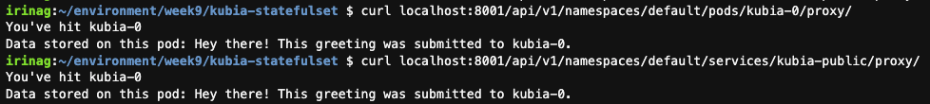
EXPOSING STATEFUL PODS THROUGH A REGULAR clusterip SERVICE
$ k create -f kubia-clusterIP.yaml
$ k proxy
$ curl localhost:8001/api/v1/namespaces/default/services/kubia-public/proxy/

Slide 46
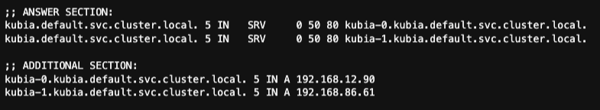
Discovering peers in a StatefulSet
Application should be K8s agnostic so querying K8s API to find all the pods in the cluster is undesirable
K8s uses DNS SRV records to facilitate the discovery. SRV records are used to point to hostnames and ports of servers providing a specific service. Kubernetes creates SRV records to point to the hostnames of the pods backing a headless service.
# create headless service
k apply -f kubia-headless.yaml
# discovering the SRV records for the kubia cluster
$ k run -it srvlookup --image=tutum/dnsutils --rm --restart=Never -- /bin/bash
# dig SRV kubia.default.svc.cluster.local
For a pod to get a list of all the other pods of a StatefulSet, all you need to do is
perform an SRV DNS lookup.

Slide 47
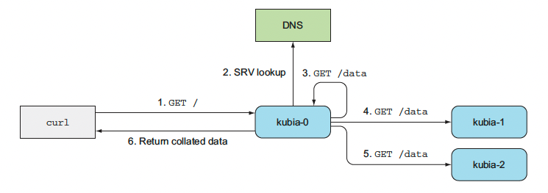
Implementing peer discovery through DNS
Data stored by individual pods is independent – this is not a cluster yet
We can improve the functionality by discovering all the pods in the StatefulSet and serving data from all the pods in the cluster
# Adding DNS lookup to obtain SRV record
https://github.com/luksa/kubernetes-in-action/blob/d15844af7b4153eb8d10ba56c5925a21205f490e/Chapter10/kubia-pet-peers-image/app.js#L46

Slide 48
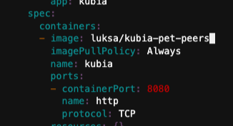
Updating a StatefulSet
$ k edit statefulset kubia # Update container image to luksa/kubia-pet-peers
$ k get po

Slide 49

Trying out our clustered data store
# Send POST to a ramdom pod though ClusterIP service
$ curl -X POST -d "The sun is shining" localhost:8001/api/v1/namespaces/default/services/kubia-public/proxy/
$ curl -X POST -d "The rain is raining" localhost:8001/api/v1/namespaces/default/services/kubia-public/proxy/
# Reading data from a clustered data store
$ curl localhost:8001/api/v1/namespaces/default/services/kubia-public/proxy/

Slide 50
Workshop 3 the end
Notes:
https://github.com/luksa/kubernetes-in-action/tree/master/Chapter06
https://aws.amazon.com/premiumsupport/knowledge-center/eks-persistent-storage/
https://kubernetes-on-aws.readthedocs.io/en/latest/user-guide/using-volumes.html

Slide 51

Cleanup
# kill proxy pkill -f 'kubectl proxy --port=8080'
# delete dashboard kubectl delete -f https://raw.githubusercontent.com/kubernetes/dashboard/${DASHBOARD_VERSION}/aio/deploy/recommended.yaml unset DASHBOARD_VERSION
# Delete the week8 namespace
$ k delete ns week8
# Delete the cluster
$ eksctl delete cluster --name clo835 --region us-east-1
# Stop cloud9 instance
Notes:
https://www.decodingdevops.com/kubernetes-configmap-tutorial-with-examples/

